Slide 1


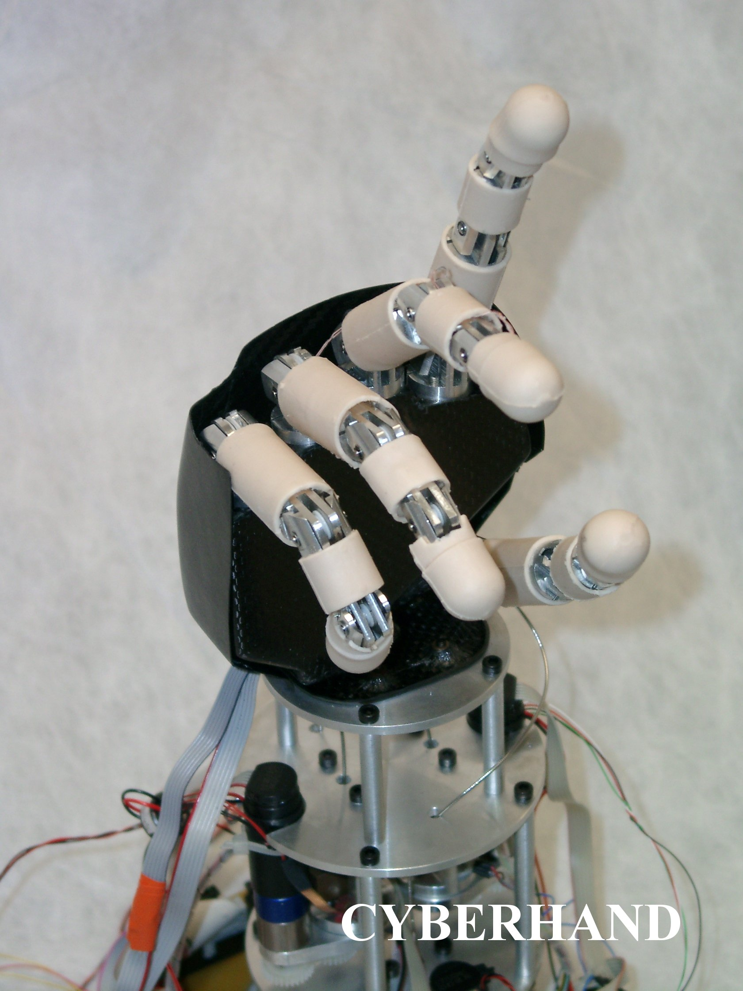
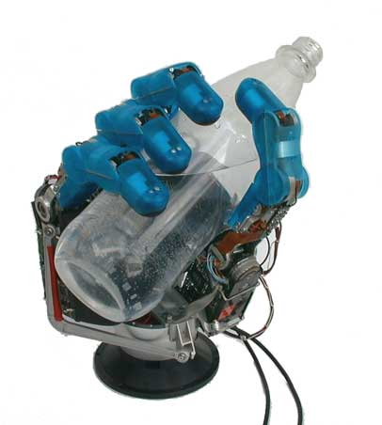
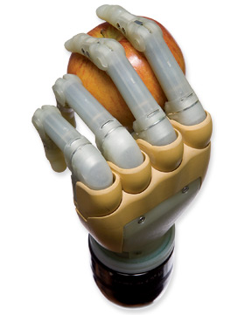
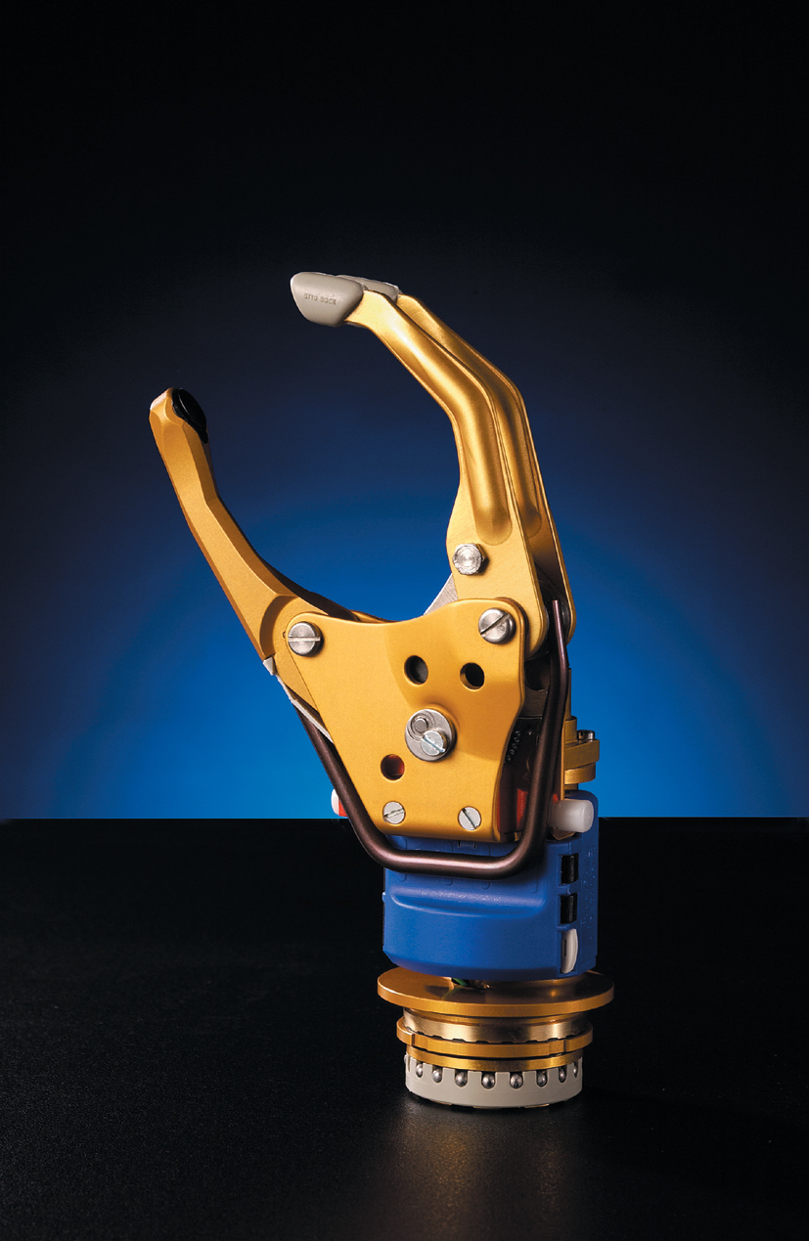
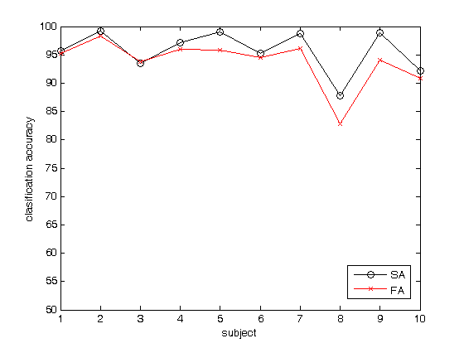
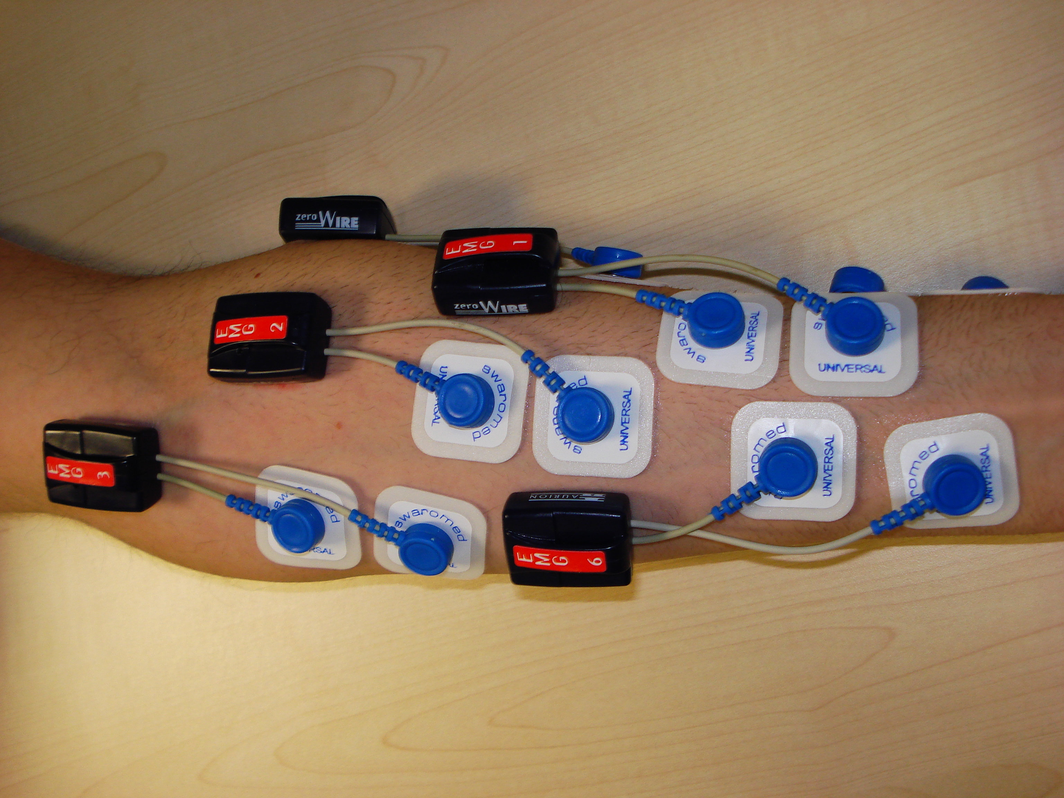
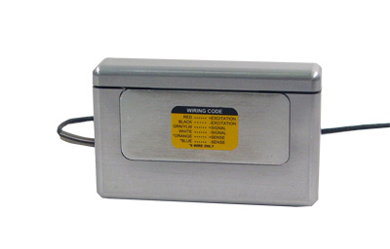
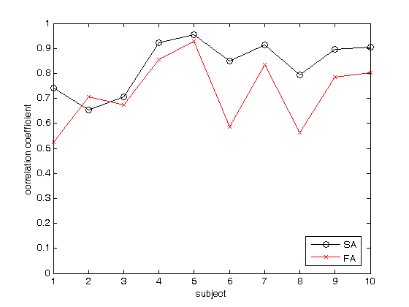
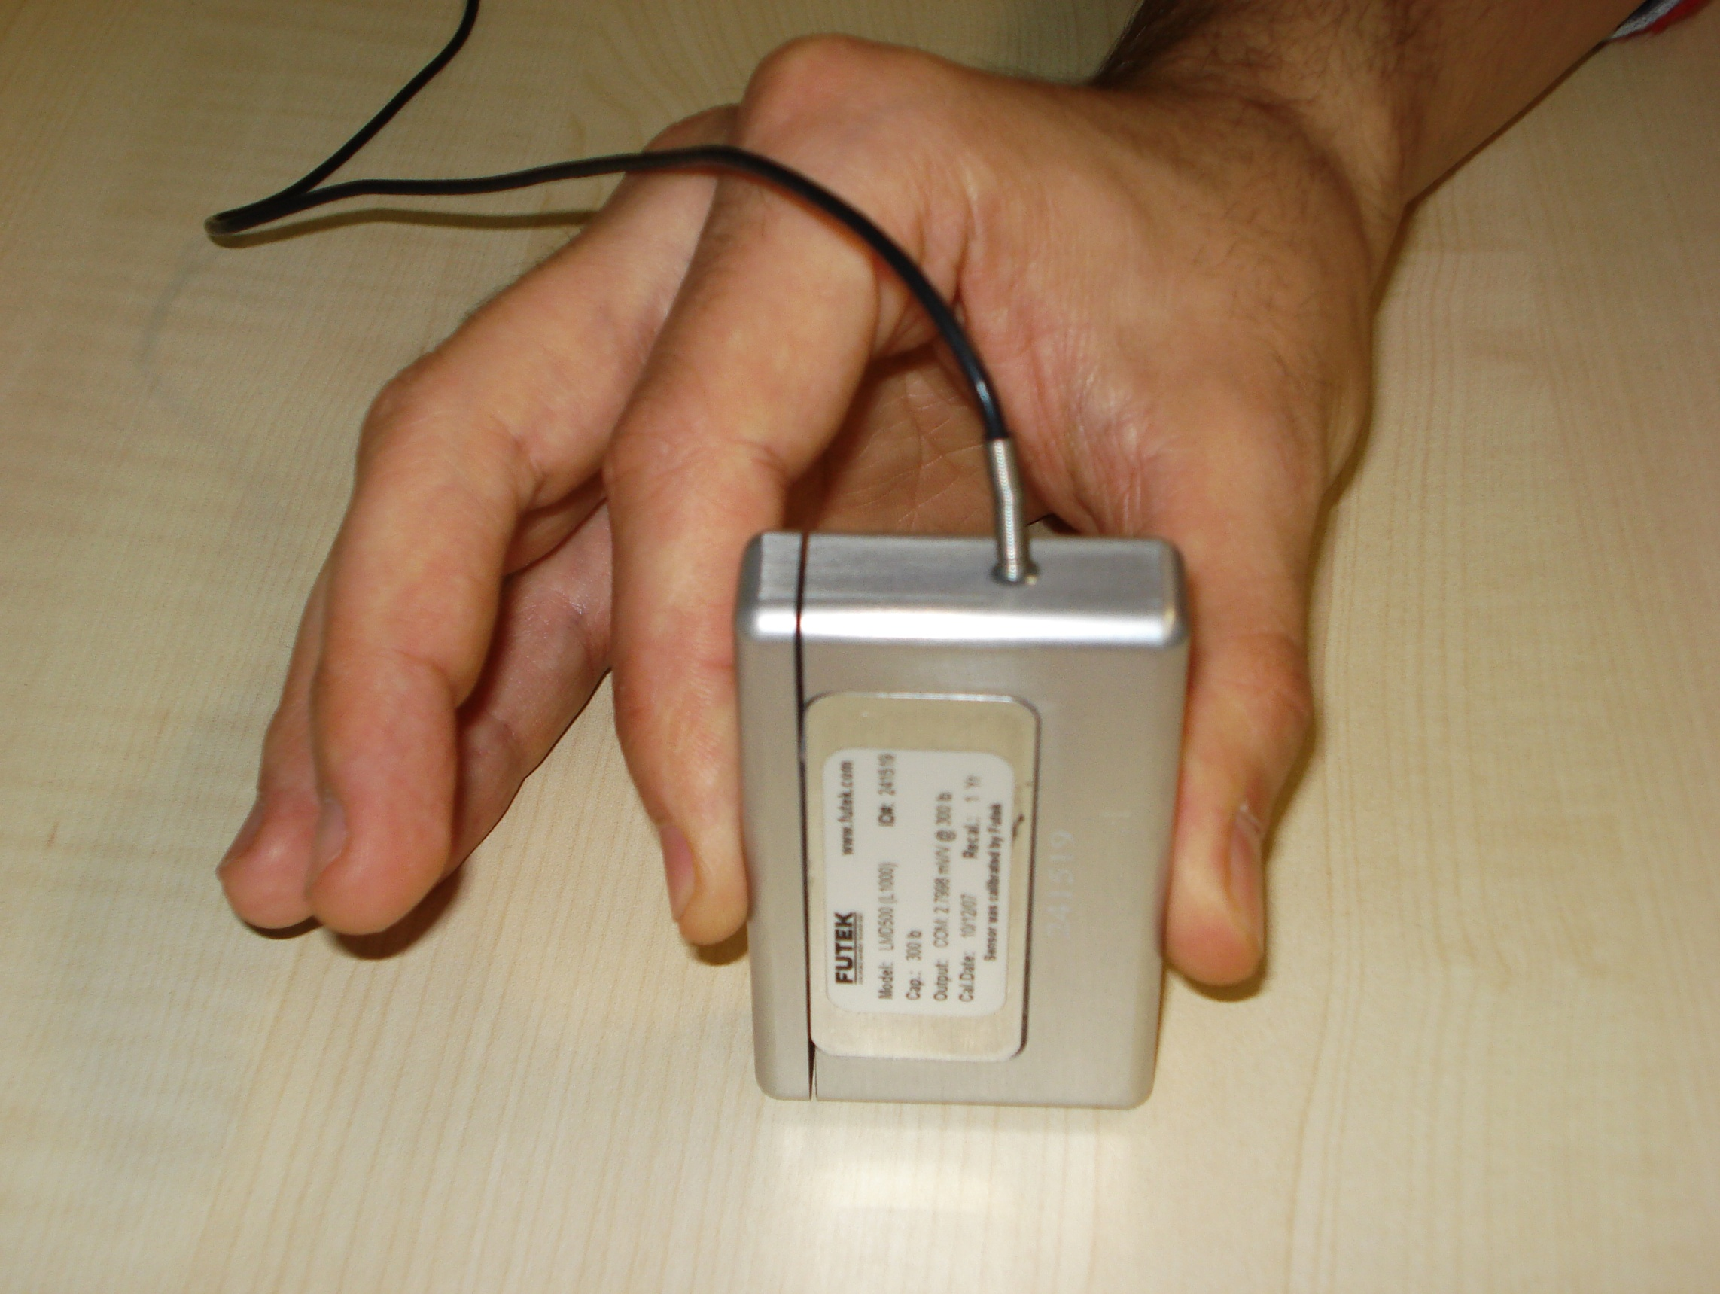
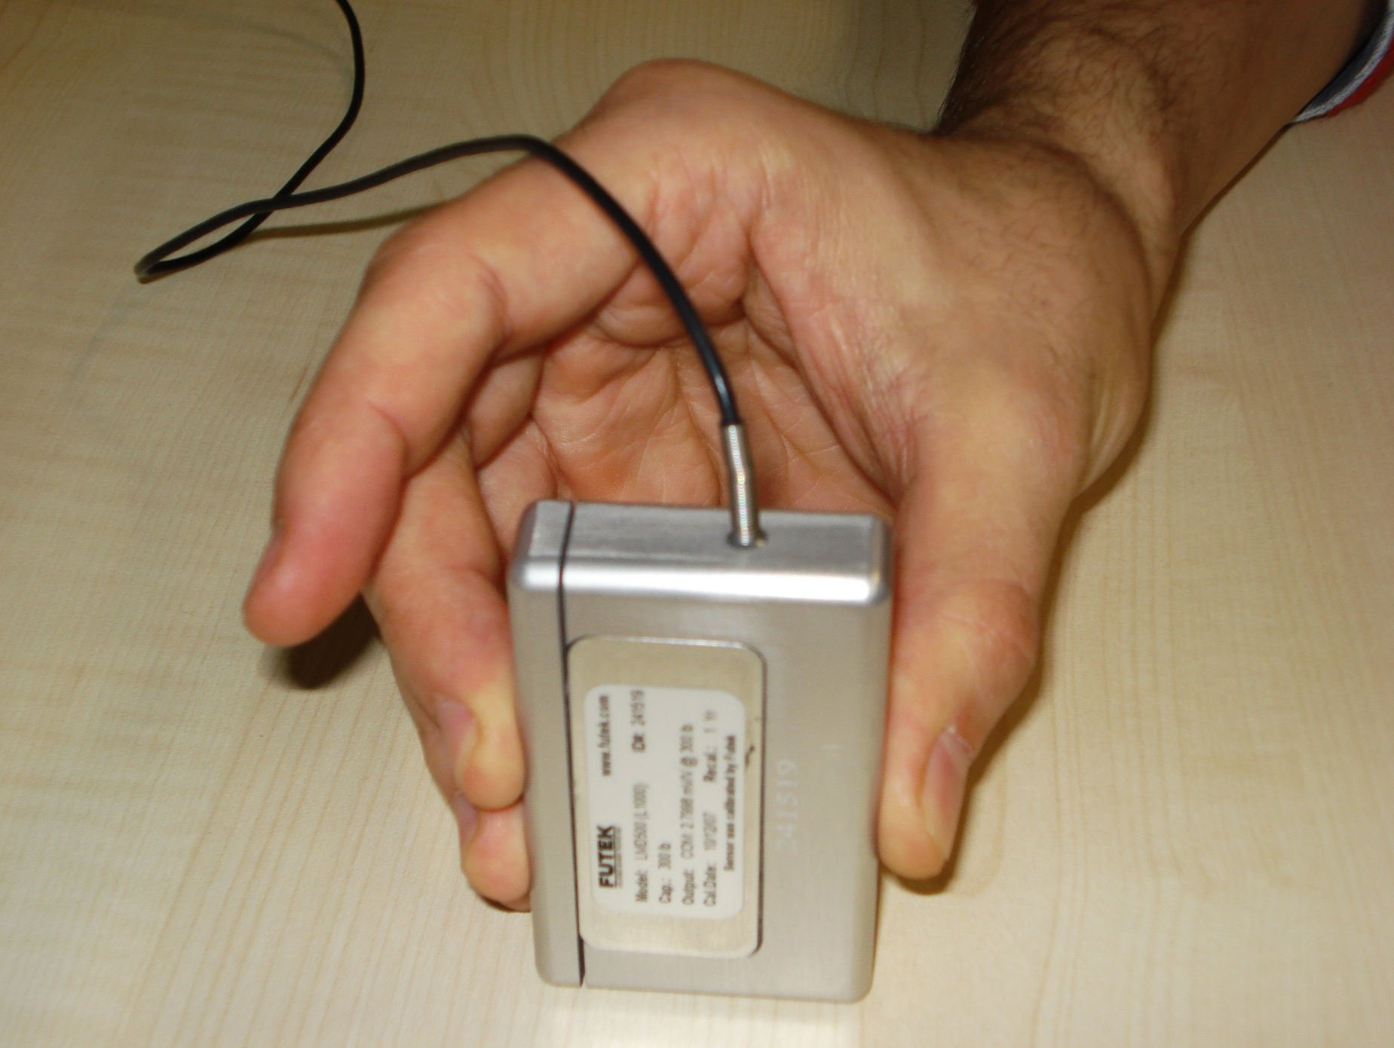
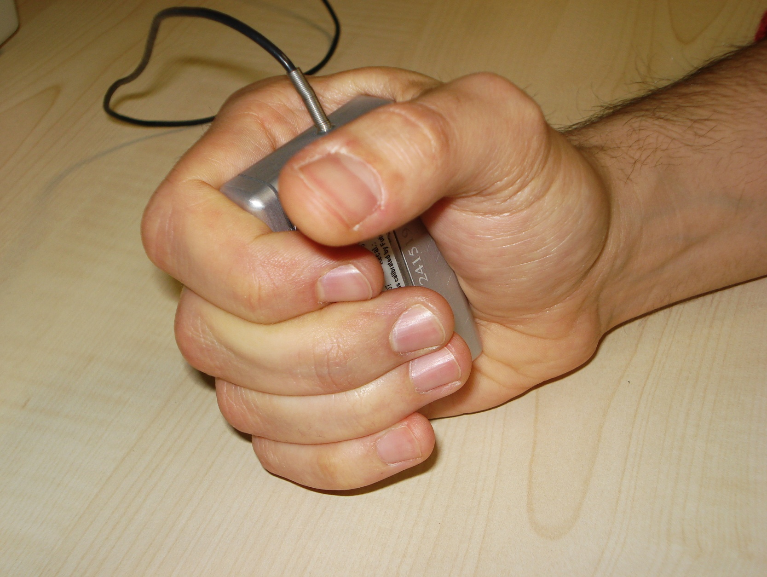
MULTI-SUBJECT / DLA ANALYSIS OF SURFACE EMG CONTROL OF MECHANICAL HANDS
C. Castellini ^{A}, A. E. Fiorilla ^{A,B}, G. Sandini ^{B}
^{A} LIRA-Lab, DIST, University of Genova, Italy
^{B} RBCS Department, Italian Institute of Technology, Genova, Italy
INTRODUCTION
Active Hand Prostheses (AHPs) are hand prostheses which can be voluntarily actuated by the patient wearing it.
At the time of writing, even the best commercially available AHPs (Otto Bock’s SensorHand and Touch Bionics’s i-LIMB) have just one DOF and/or are non-naturally controlled by, at best, two or three surface EMG electrodes.
DATA ANALYSIS
Analysis is performed in three main steps:
the Root Mean Square (RMS) of the EMG signals is computed over a fixed time-window – this operation is well-known to produce a signal that is highly related to the muscular force;
On-line Uniformization (OU) is applied in order to reduce the number of samples given to the machine learning system without over-degrading its performance²;
a Support Vector Machine (SVM) with Gaussian kernel is employed to map EMG signals to types of grasp (classification) and to required force values (regression).
Force Measurements
EMG
Stored Data
RMS
Computation
On-line
Uniformization
SVM Classification
Training
Classification model
Examples of hand prosthetic devices / dexterous robotic hands
SVM Regression
Training
Regression Model
Nevertheless, the mechatronics of AHPs is getting better and, with the aim of enabling a patient to finely control the forthcoming AHPs, forearm surface EMG can be used to detect in real-time both what kind of grasp a human subject is willing to use and how much force is required^{2,3,4}.
The aim of this work is to perform 1) multi-subject and 2) Daily-Life Activities (DLA) analysis of the EMG signal, applied to AHPs.
Grasp Label
RESULTS
Evaluation is done via grid search across 5-fold cross-validation; the results are highly encouraging. The resulting models are:
excellent in classification (accuracy: 95.73% ± 3.76% for SA, 93.74% ± 4.32% for FA);
very good in regression (correlation coefficient: 0.83 ± 0.1 for SA, 0.73 ± 0.14 for FA).
Moreover, results are consistent by experiment and by subject, i.e., hard subjects are hard both in FA and SA, and FA is consistently harder than SA.
METHODS
Ten healthy subjects, two women and eight men, participated in the experiment;
Seven single-differential Aurion ZeroWire wireless electrodes for surface EMG were placed on the dominant arm of the subjects in order to detect the activity of the most relevant flexor and extensor muscles;
a FUTEK LMD500 force sensor was used to detect the force involved in the grasping;
a standard DAQ card was employed to acquire the signals (f_{s} = 2 KHz).
a) position of the EMG electrodes (ventral side) b) the FUTEK force sensor
Required task:
The subjects, their arm still and relaxed on a table (Still-Arm experiment - SA), were asked to grasp the sensor, in turn, in three different ways:
index precision grip (a);
other fingers precision grip (b);
power grasp (c).
The subjects freely repeated each grasping action for 100”, resting for 30” in between grasps. The procedure was repeated twice, in order to gather more data and diminish the effects of local, statistically irrelevant, errors.
Subsequently the subjects were required to perform the same task while freely moving, walking around, lifting and pronating or supinating their arm and forearm (Free-Arm experiment - FA), as one is expected to do in DLAs.
CONCLUSIONS
Surface EMG can be used to classify grasps and predict the involved force, within a broad range of human subjects, even if these subjects act in non-highly controlled conditions, as while performing Daily Life Activities. Further initial experiments on an amputee⁷ confirm that the approach is feasible.
REFERENCES
[1] H. Huang, L. Jiang, D. Zhao, J. Zhao, H. Cai, H. Liu, P. Meusel, B. Willberg, and G. Hirzinger, The development on a new biomechatronic prosthetic hand based on under-actuated mechanism, in Proceedings of IROS 2006, 2006, pp. 3791—3796.
[2] C. Castellini and P. van der Smagt, Surface EMG in Advanced Hand Prosthetics, to appear in Biological Cybernetics, 2008.
[3] M. Zecca, S. Micera, M. C. Carrozza and P. Dario, Control of Multifunctional Prosthetic Hands by Processing the Electromyographic Signal, Critical Reviews in Biomedical Engineering, 30(4–6):459–485, 2002.
[4] S. Bitzer and P. van der Smagt, Learning EMG control of a robotic hand: Towards active prostheses, in Proceedings of ICRA, International Conference on Robotics and Automation, Orlando, Florida, USA, May 2006, pp. 2819—2823.
[5] C. J. De Luca, The use of surface electromyography in biomechanics, Journal of Applied Biomechanics, 13:135-163, 1997.
[6] B. E. Boser, I. M. Guyon, and V. N. Vapnik, A training algorithm for optimal margin classifiers, in Proceedings of the 5th Annual ACM COLT Workshop, ACM press, 1992, pp. 144–152.
[7] C. Castellini, E. Gruppioni, A. Davalli and G. Sandini, EMG-driven hand prosthetics: initial results on a patient, poster at the I Neuro-Robotics Symposium, Freiburg, Germany, 2008.
(a)
(b)
(c)
The system is required to classify and estimate the force during three different grasp tasks

